Slide 1


APSSDC
Website Traffic
Analysis
Presented by:
Chakradhar Parimi
Shaik Kudhan
Duggivalasa Pragathi

Slide 2

CONTENTS
Abstract
Introduction
Software Requirements
Libraries
Architecture
Advantages of the project
Conclusion

Slide 3


Abstarct
This project presents a comprehensive analysis of website traffic to uncover actionable insights into user behavior, traffic source effectiveness, and factors influencing conversion rates. Leveraging Python libraries such as Pandas, NumPy, and Matplotlib, the dataset undergoes rigorous preprocessing, cleaning, and filtering to ensure reliability. Through 20+ targeted queries and intuitive visualizations—like scatter plots, pie charts, and line graphs—the analysis reveals patterns in session duration, bounce rates, and user engagement. Key findings highlight which channels yield the most loyal visitors, how time on page affects conversion, and which traffic sources demand optimization. The project culminates in a structured framework for data-driven decision-making, empowering businesses to enhance digital strategies, boost user retention, and improve overall site performance.

Slide 4
Introduction
In today’s data-driven digital landscape, understanding website traffic is not just an advantage—it’s essential. Every click, scroll, and session contributes valuable insights into how users interact with digital platforms. This project explores a comprehensive website traffic dataset to extract patterns in user behavior, traffic source effectiveness, and engagement metrics that influence conversion performance. By using Python's powerful libraries—Pandas for manipulation, NumPy for numeric computation, and Matplotlib for visualization—the project walks through a full analytical pipeline from data cleaning to insightful visual exploration. The primary aim is to turn raw data into a clear narrative, empowering businesses and digital strategists to make informed decisions that enhance user experience, optimize acquisition channels, and ultimately drive growth.

Slide 5
PROBLEM STATEMENT
Lack of clarity in user engagement patterns
Uncertainty about which traffic sources convert well
Need to identify and act on conversion bottlenecks

Slide 6
OBJECTIVES
Analyze website visitor behavior and sources
Visualize engagement and conversion patterns
Uncover factors influencing bounce and conversion rate

Slide 7
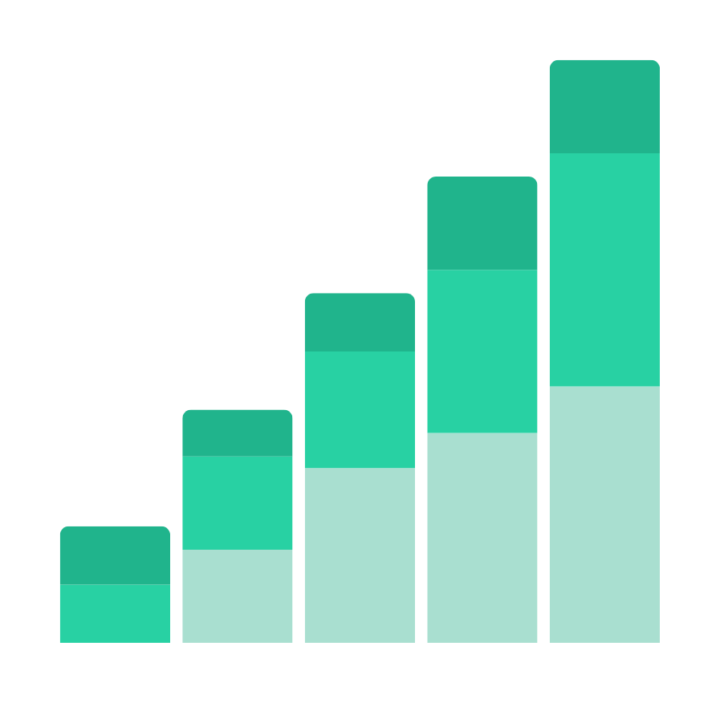
Software requirements
Operating System: Windows 11
Software: Jupyter Notebook / Python
Hardware: Minimum 4GB RAM
Programming Language: Python 3
Libraries: Pandas, NumPy, Matplotlib

Slide 8
LIBRARIES
PANDAS
NUMPY
MATPLOTLIB
This library is used to handle and manipulate data in a tabular form. It helps in reading datasets, filtering rows, applying queries, grouping data, and generating summaries easily.
Essential for numerical operations, NumPy provides fast and powerful tools for performing mathematical functions like mean, variance, and other statistical calculations on arrays and columns.
Used to visualize data through charts and plots such as histograms, scatter plots, pie charts, and line graphs. It helps convert raw numbers into visual patterns for better understanding.

Slide 9

PROJECT DEVELOPMENT STEPS
1. Dataset loading
2. 15+ basic exploratory queries
3. Cleaning (nulls, types, duplicates)
4. Filtering, grouping, aggregation
5. Visualization with 5+ plots

Slide 10
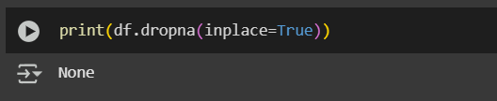
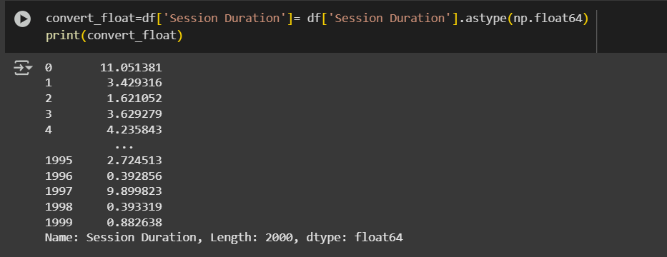
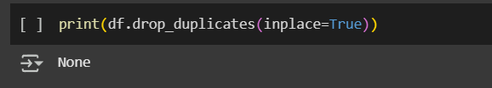
DATA CLEANING
Data cleaning is a crucial step in the data analysis process that ensures accuracy and consistency. It involves removing duplicate entries, handling missing or null values, correcting data types, and resolving formatting issues. By cleaning the dataset, we eliminate noise and errors that could distort results, paving the way for reliable insights and meaningful visualizations

Slide 11
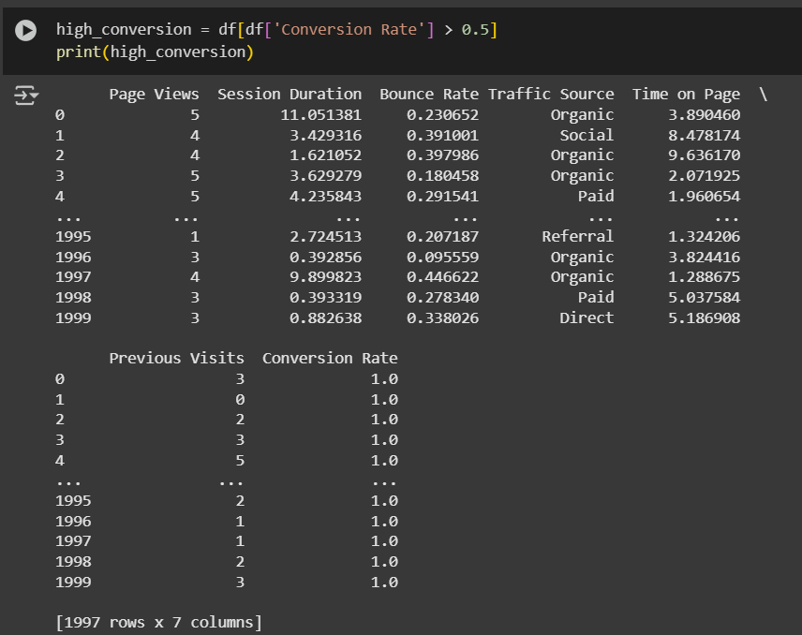
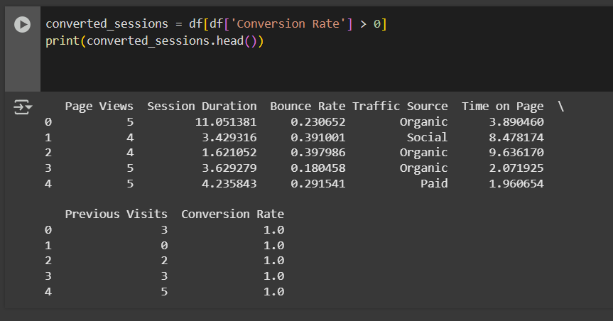
FILTERING DATA
Data filtering allows us to isolate specific patterns and behaviors within the dataset. By applying logical conditions—such as selecting users with high bounce rates or those who converted—we can focus on segments that matter most. This helps uncover targeted insights for optimization.

Slide 12
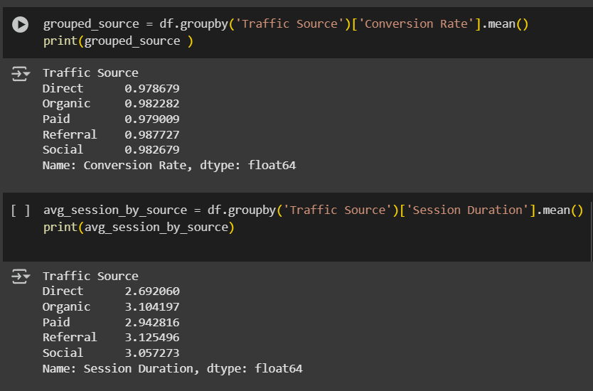
Grouping & Aggregation
Grouping and aggregation help summarize large volumes of data in a meaningful way. For instance, by grouping by traffic source and calculating average session durations or conversion rates, we can identify which channels perform best and where improvement is needed.

Slide 13
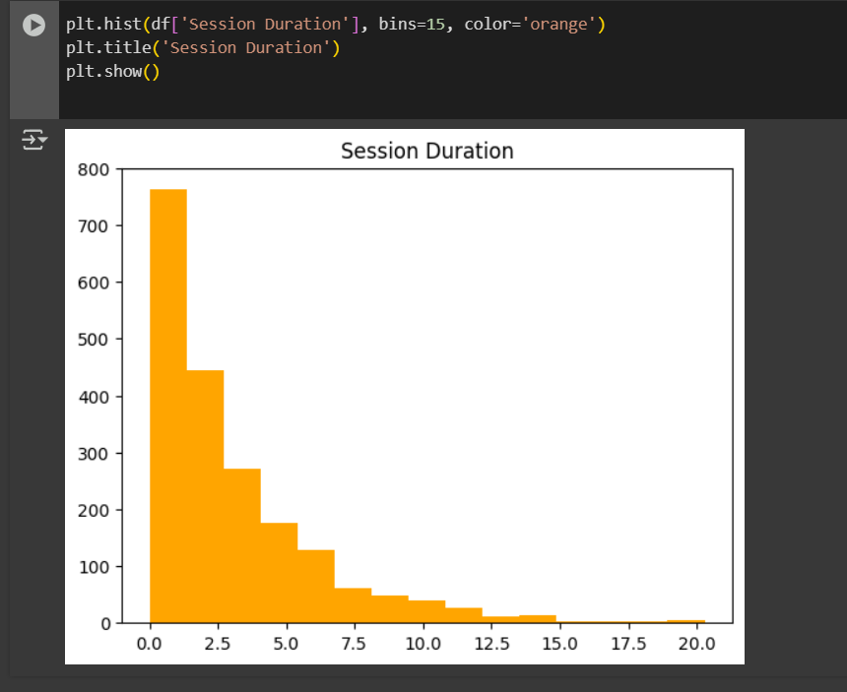
VISUALIZATION
Data visualization transforms raw numbers into clear, compelling insights. In this project, a variety of plots—such as histograms, scatter plots, pie charts, boxplots, and line graphs—were used to explore user engagement, traffic source performance, and conversion behavior. Each chart highlights a specific angle of analysis, making it easier to identify trends, compare categories, and communicate results effectively. Visual storytelling not only strengthens understanding but also supports data-driven decision-making.
HISTOGRAM
This plot shows the distribution of session durations across all users. It helps identify how long users typically spend on the site and whether there are any spikes in extremely short or long sessions, signaling either quick exits or highly engaged visitors.
Q. What is the typical session duration for users, and are there any significant spikes in very short or long sessions?

Slide 14
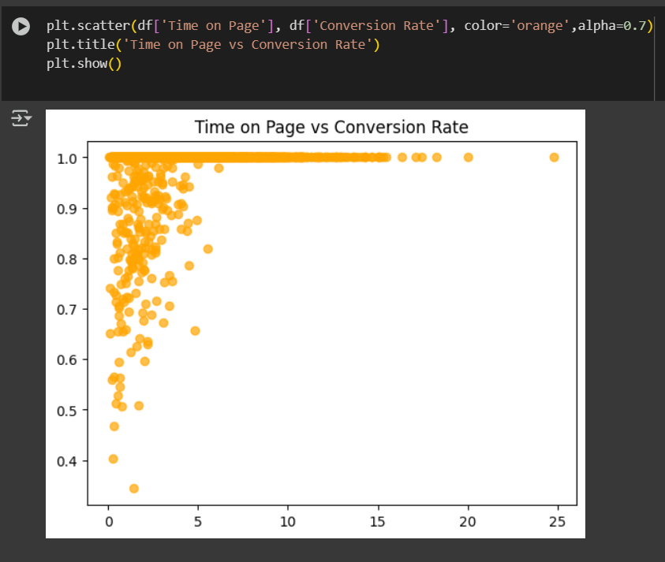
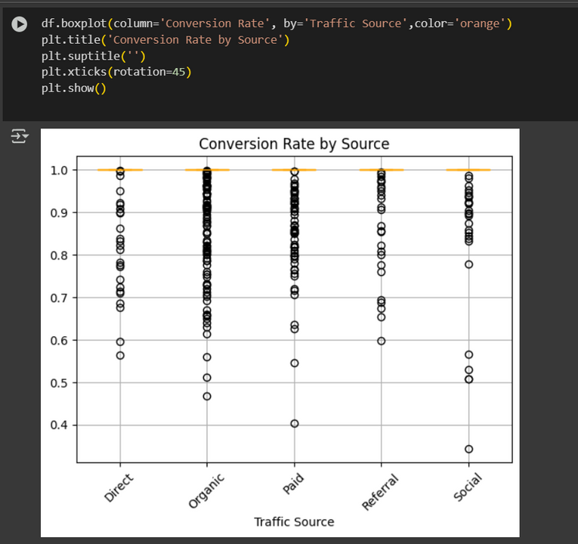
BOX PLOT
SCATTER PLOT
This chart reveals the spread and central tendency of conversion rates for each traffic source. It’s useful for spotting sources with reliable performance and those with high variance, which may indicate instability or opportunity.
This visualization highlights the relationship between time spent on a webpage and the user's likelihood to convert. It reveals whether higher engagement translates into better conversion outcomes or if there's a point of diminishing returns.
Q. Which traffic sources lead to the highest or most consistent conversion rates, and are there any sources with a wide range of outcomes?
Q. Is there a relationship between how long a user spends on a page and their likelihood of converting?

Slide 15
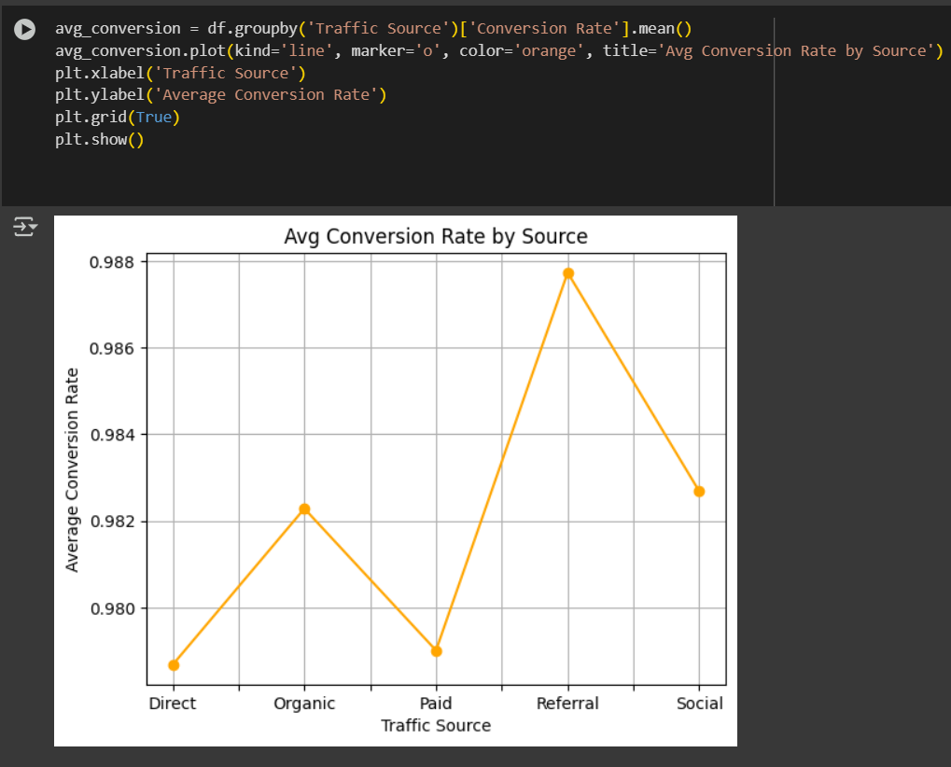
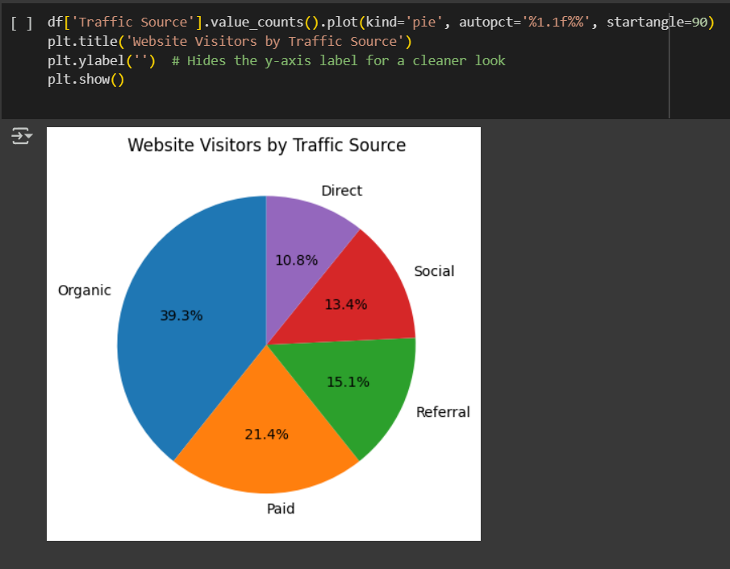
LINE PLOT
PIE CHART
The line plot showcases how different traffic sources perform in terms of conversion efficiency. It helps compare sources side-by-side and detect which ones consistently contribute to valuable user actions.
This chart displays the percentage share of visitors coming from each traffic channel (e.g., Organic, Direct, Referral). It gives an immediate snapshot of which sources dominate traffic and whether the strategy is balanced or overly dependent on one channel.
Q. Which traffic source leads to the highest average conversion rate, and how do the others compare in performance?
Q. What proportion of website traffic is coming from each source, and are certain channels significantly more dominant than others

Slide 16

CONCLUSION
This project successfully uncovered valuable insights into website user behavior by leveraging Python-based data analysis and visualization techniques. From identifying high-performing traffic sources to revealing patterns in session duration and conversion rates, each step contributed to a deeper understanding of digital engagement. The visualizations provided intuitive clarity, while filtering and grouping techniques sharpened the focus on user segments. Overall, this project demonstrates the power of data-driven decision-making in optimizing web strategies and enhancing user experience.

Slide 17

Thank you very much!

